Slide 1
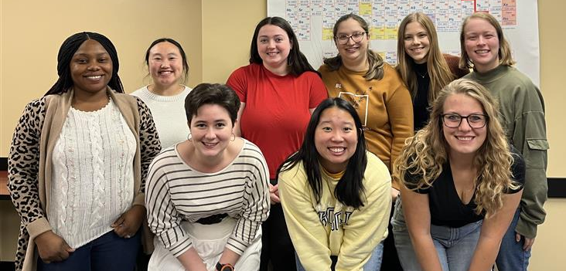
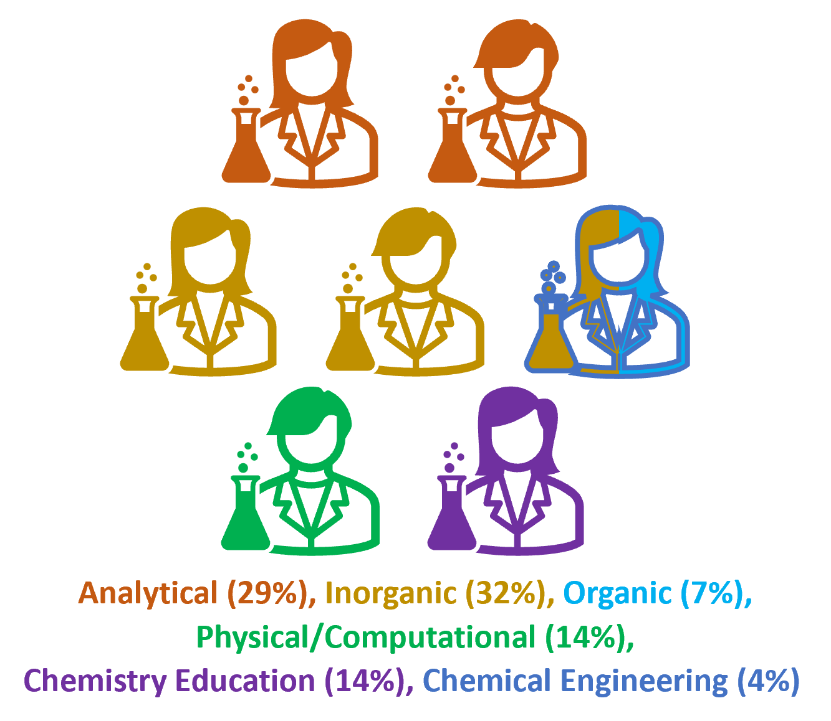
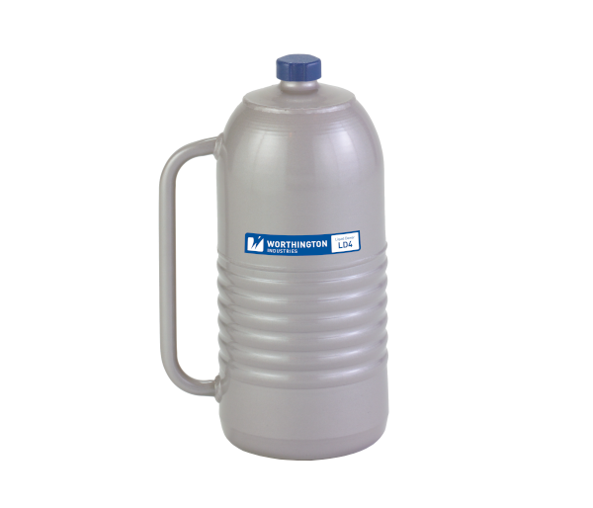
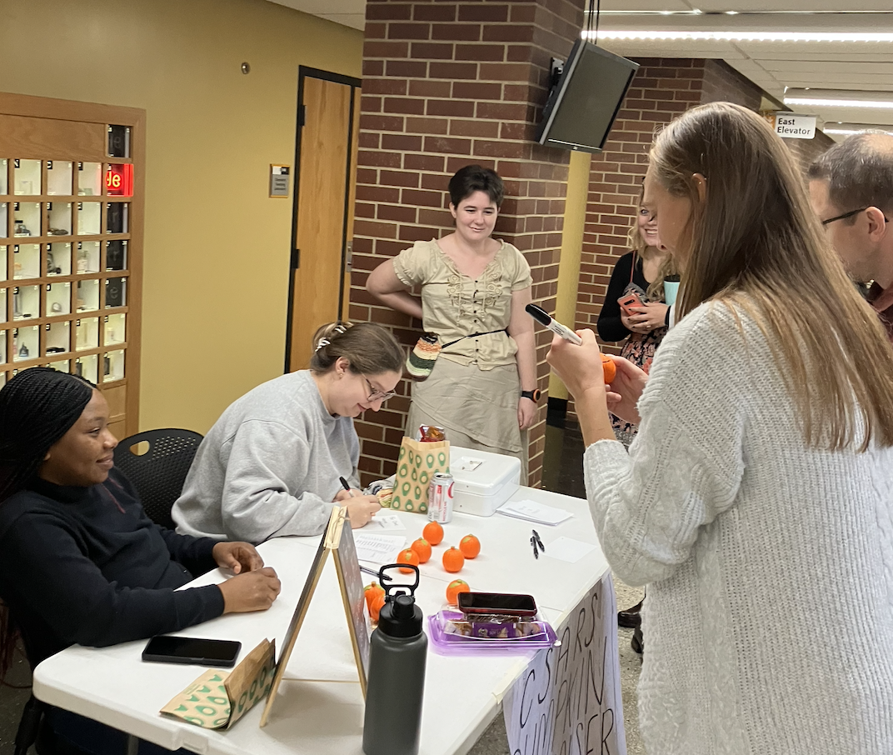
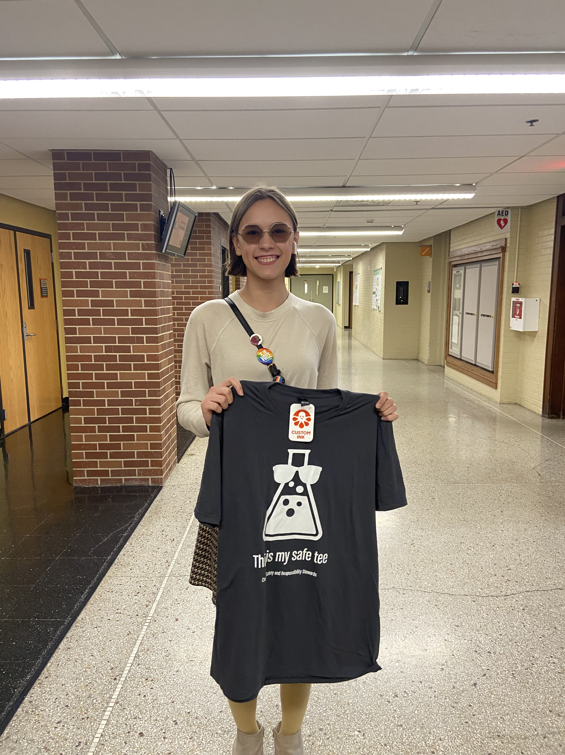
Safety Times
Hello!
CSARS is excited to introduce our bimonthly newsletter. This short newsletter will include safety tips, Safe-Tee winners, departmental safety updates, and information about any upcoming CSARS/safety events! Have ideas for us to include in future newsletters? Suggest them here!
CSARS stands for Chemical Safety and Responsibility Stewards. We are a Graduate Student organization in the Department of Chemistry. Our Mission is to promote chemical safety awareness within our department, and to enhance the safety culture! We work to ensure everyone in the department receives important safety-related information, and to develop and provide resources on safety best practices. Whether you’re actively working in a research laboratory, teaching an undergraduate lab, taking classes, or just want to keep up to date on the protocols, we’ve got something for you! Interested in Joining? Stop by our next meeting, December 13th in W323 or check out our website for more information. Don’t worry if your work isn’t in a lab or traditional area of study.
Handling Liquid Nitrogen
Cryogenic liquids contain hazards with rapid freezing, asphyxiation, pressure buildup, and explosions.
Safety measures: Liquid nitrogen should always be handled in well-ventilated areas with properly insulated containment vessels.
PPE: Wear a face shield or goggles, long sleeves and pants, and thermally-insulated or leather gloves.
EHS - Liquid Nitrogen
We’re from every area of chemistry research, including dry labs and computational! Our current board includes Darby Duffy [Chair, Analytical & Inorganic], Emma Markun [Vice-Chair, Inorganic], Hannah Nennig [Archivist, Chemical Education], Heather Koska [Communications, Organic], Hannah Hansen [Social Media, Inorganic & Physical], and Nicole Shapiro [Maintenance, Inorganic & Engineering].
Thank you for supporting the CSARS pumpkin stress ball sale!
Contact us for more info:
Next meeting:
Dec 13th 4:30-5:30 pm, W323 CB
Chair: Darby Duffy
darby-duffy@uiowa.edu
Website: https://csars.org.uiowa.edu/
Twitter:
@UIowaCSARS
Nominate for safe-tee raffle!
Safe- Tee initiative:
Aleena L. "consistently demonstrates exemplary safe behavior within the chemistry laboratory. She approaches her work with a meticulous and cautious attitude, ensuring that all necessary safety protocols and procedures are strictly followed. […] Her collaborative spirit fosters an environment where everyone is informed and committed to maintaining a secure workspace.” Thanks for being safe Aleena!

